Slide 1
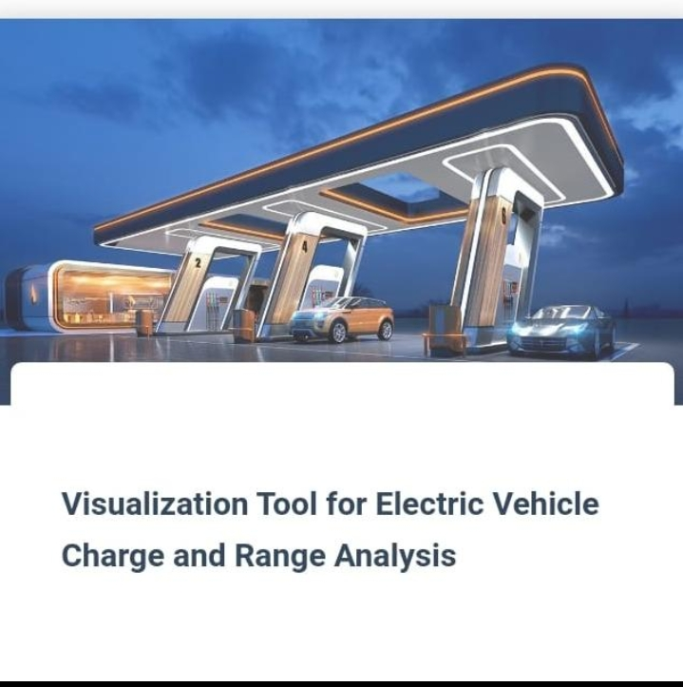
Visualization Tool For electric vehicle charge and range analysis

Slide 2
Electric vehicle :
Electric vehicle is not new , but it has been receiving significantly more att ention in recent years.
Advance in both EV analytics and battery technologies have led to increased automotive market share.
The modern mechatronic vehicle marries electrical storage and propulsion systems with electronic sensors, controls,and actutors, integratedclosely with software.

Slide 3
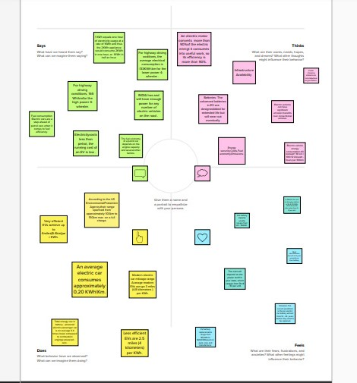
Design Thinking

Slide 4
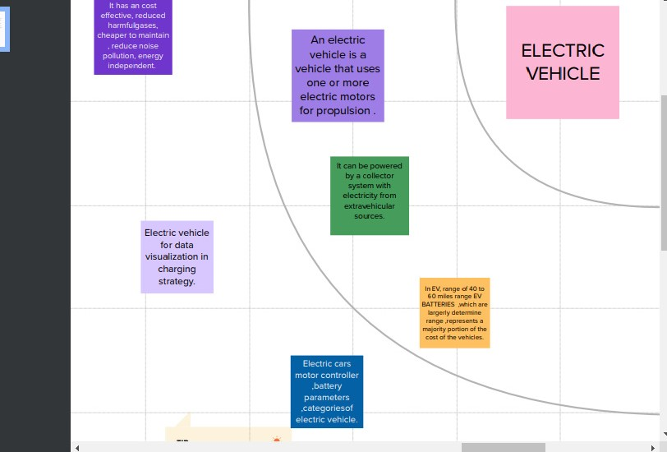
Graphical representation

Slide 5
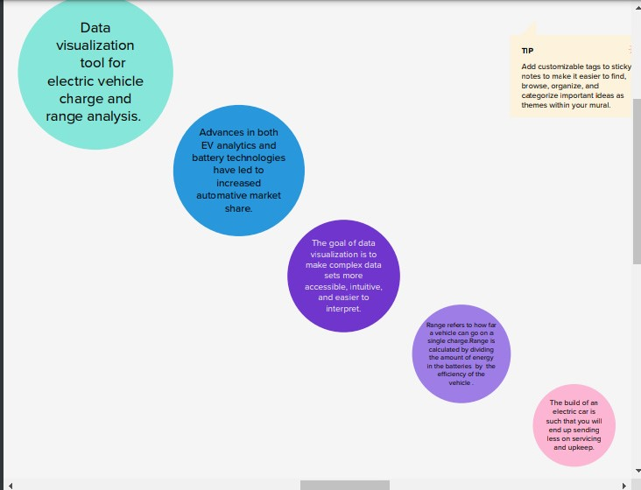
Brainstorm ideas

Slide 6
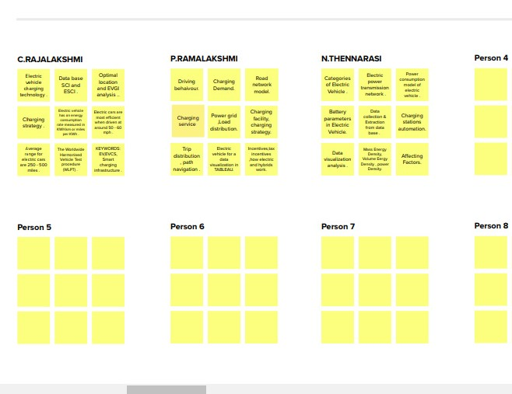
Group ideas

Slide 7
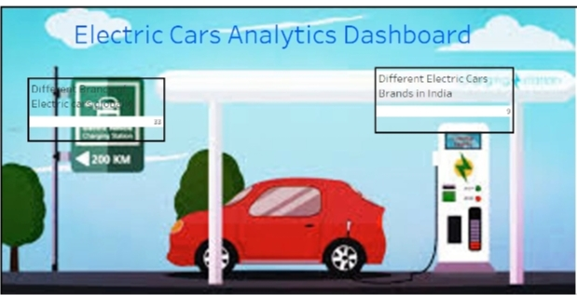
Dashboards

Slide 8
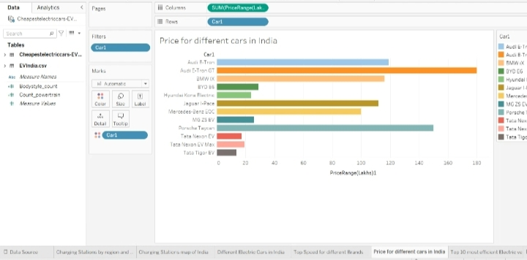

Slide 9
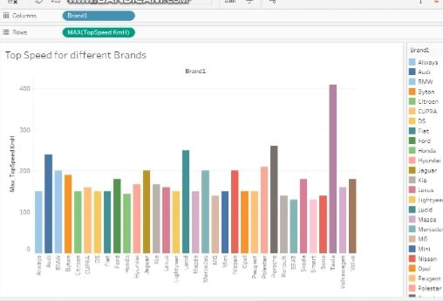

Slide 10
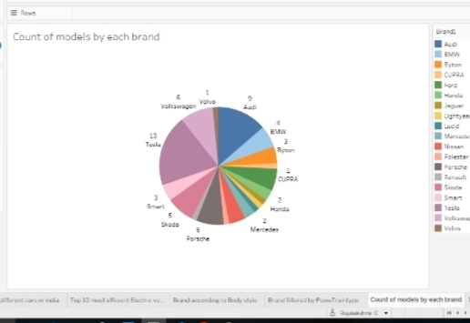

Slide 11
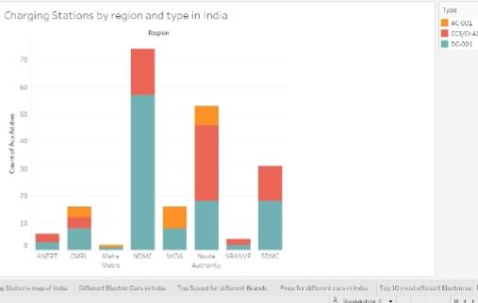

Slide 12
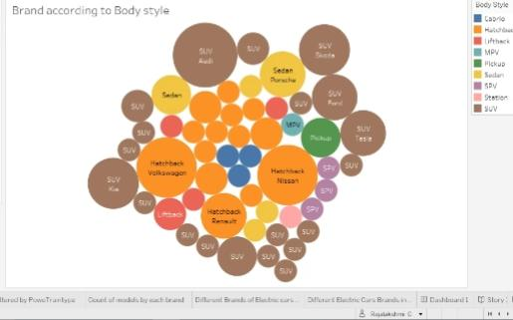

Slide 13
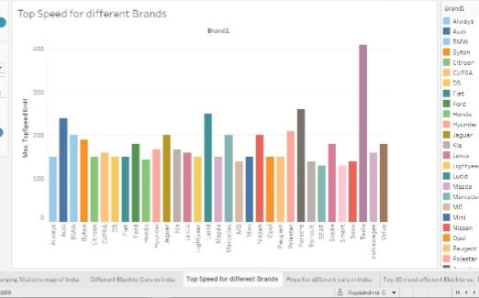

Slide 14
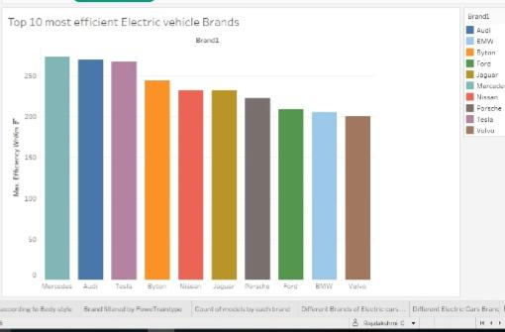

Slide 15
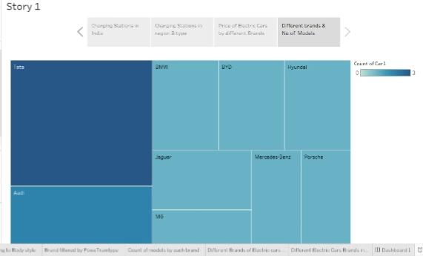
Story

Slide 16

Source code

Slide 17


Slide 18
Summary :
Electric vehicle charging technology .
Charging strategy.
Categories of electric vehicle.
Charging stations automations .
Data visualization analysis.
Charging demand.

Slide 19
Electric vehicles in data visualization :
An Electric vehicle Is a vehicle that uses one or more electric motors for propulsions.
Electric vehicle for data visualization in charging strategy.
It can be powered by a collector system with electricity from extra vehicular source.

Slide 20
Team leader : c.rajalakshmi team members : p.ramalakshmi n.thennarasi

